Slide 1
Artificial intelligence Canada School of Public Service Digital Academy

Slide 2

Defined
Artificial intelligence (AI)
is a term used to describe a suite of related technologies intended to simulate and enhance human cognitive capabilities, such as pattern recognition, judgement, vision, or hearing.
2
Notes:
Complexity image is a Creative Commons 3.0 licenced image from user:LukeGoodsell on Wikimedia commons: https://en.wikipedia.org/wiki/File:Ribosome-Nascent_chain_complex.png

Slide 3

Branches of AI
Machine learning
Natural language processing
Expert systems
Artificial intelligence
Speech
Planning
Vision
Vision
Robotics
3
Notes:
https://blogs.wsj.com/cio/2016/07/18/cio-explainer-what-is-artificial-intelligence/

Slide 4
More definitions
DATA ANALYTICS
The accumulation, analysis, reporting, and presentation (visualization) of historical business data to improve visibility into organizational operations, research problems, trends, and more.
DATA SCIENCE
Applying algorithms to numbers, text, images, audio, and more to produce systems that identify useful generalizable patterns in data. In turn, these systems generate insights that analysts and business users translate into business value.
PREDICTIVE ANALYTICS
A type of analysis that uses historical data to understand real time data and make future predictions.
DEEP LEARNING
An advanced form of machine learning where neural networks are expanded into sprawling networks that are trained using massive amounts of data (e.g., facial recognition.)
MACHINE LEARNING
Computer systems fed large amounts of data which is used to learn how to carry out a specific task (e.g., automated captioning.)
4
Thank you to NRCan for these definitions.

Slide 5




Why is everyone talking about AI?
Explosion in available data
Open source and open access to software
Increase in computing power
Open source or proprietary models, models, algorithms, and techniques
5
Notes:
McKinsey: AI will add 1.2 additional GDP growth per year, or 16% higher than otherwise by 2030 with 70% of companies using at least some kind of AI technology.
https://www.mckinsey.com/featured-insights/artificial-intelligence/notes-from-the-ai-frontier-modeling-the-impact-of-ai-on-the-world-economy?reload
Leading AI countries could capture an additional 20 to 25 percent in net economic benefits, compared with today, while developing countries might capture only about 5 to 15 percent
Osborne/Frey suggest 47 percent of the U.S. workforce is at risk of automation, whereas the OECD suggests that 9 percent of the workforce across OECD countries is at risk, with up to 50 percent of tasks changing for an additional 25 percent.

Slide 6
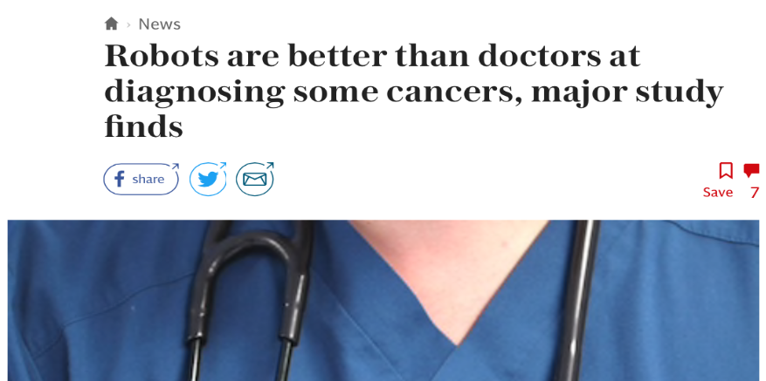
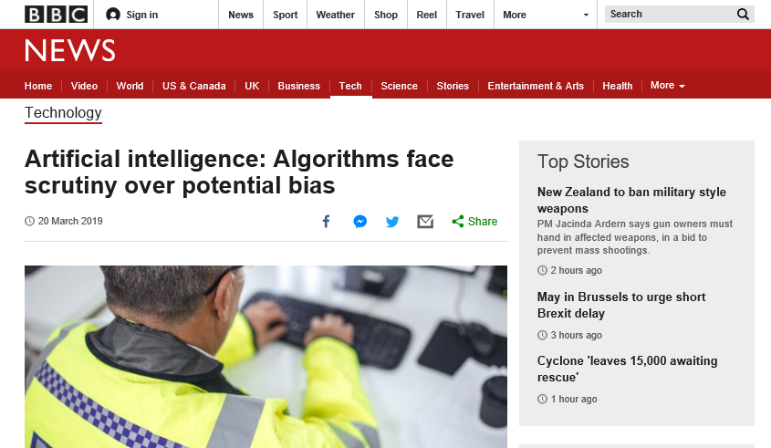
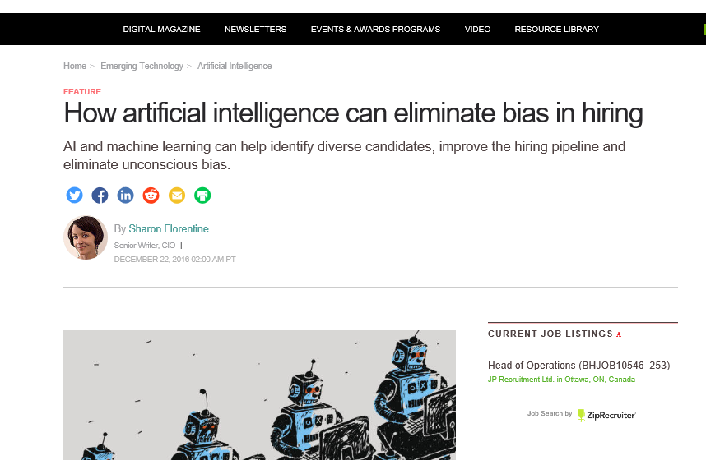








Promise and peril
6

Slide 7
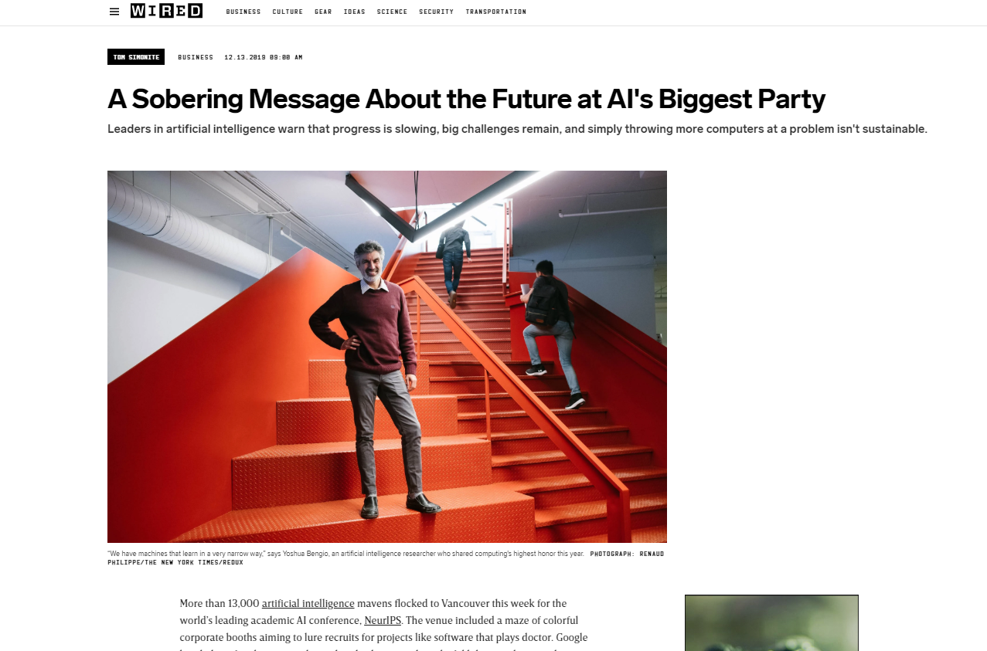
Predictions and discourse are changing
“…progress is slowing, big challenges remain, and simply throwing more computers at a problem isn’t sustainable.
”
7

Slide 8
Public opinion
Canadians are still wary about AI making decisions instead of humans…
…though government could be a leader in building trust.
8
Notes:
Ipsos 2018

Slide 9
How it’s being used in the GC
Better public
decisions
Service and
operations
Risk-based regulation
and compliance
Open policy
development
Automation of routine activities
Sustainable and inclusive growth
Improved analysis of complex data and information
Analyzing public engagement input
Improved surveillance, monitoring, and tracking
Safety and security
More rapid provision of information and analysis
New sources of insight
Large Data
Better targeting of inspections and testing
Unseen Patterns
Increased accuracy of forecasts
9

Slide 10



How it’s being used in the GC
Public Health
Natural Resources
Transport
Engagement
Early warning analytic tool to detect potential public health threats worldwide
Early emergency warning and real-time extreme forest fire prediction and flood mapping
Risk-based oversight of air cargo information
Categorization and analysis of massive volume of qualitative input
11

Slide 11



Example: AI for regulatory insights
CSPS and eight departments exploring whether we can answer questions like:
Does regulation language encourage more or less private section innovation? How?
Can we identify gaps and overlaps in our regulatory environment?
Can we map regulatory burden across industries and jurisdictions?
Can we find insights in documents submitted as regulatory requirements?
2,600 federal regulations and more from other jurisdictions
AI applications and models supplied by up to 74 private sector firms
11
Notes:
https://www.canada.ca/en/government/system/digital-government/responsible-use-ai.html

Slide 12
An interconnected and complex system
Government promotes AI research, opening new possibilities and accelerating economic growth
Government have to evolve capacities and skills
Progress appears in service improvements and smarter government
AI
Societal impacts demand review of the legal and policy environment
AI advances influence labour market and societal trends
12

Slide 13
Challenges
Lack of training and skills
Resources and training
Developing new skills sets/training for staff
Timely access and training to latest advances in computing
Technical advice on how to apply AI into business practices
Gaps in existing policy and governance
Guidance related to stewardship of data
Proper management of ethical issues and potential biases
Balance of transparency and privacy
Aging infrastructure
Aging infrastructure
Access and use of high quality data
In-expensive computing capacity
Providing funding
Providing funding to appropriate opportunities
Necessary support for SBDAs to experiment (like GRDI)
Procurement
Outdated procurement practices
Ability to easily procure AI services, solutions, and products
13
Notes:
https://www.canada.ca/en/government/system/digital-government/responsible-use-ai.html

Slide 14
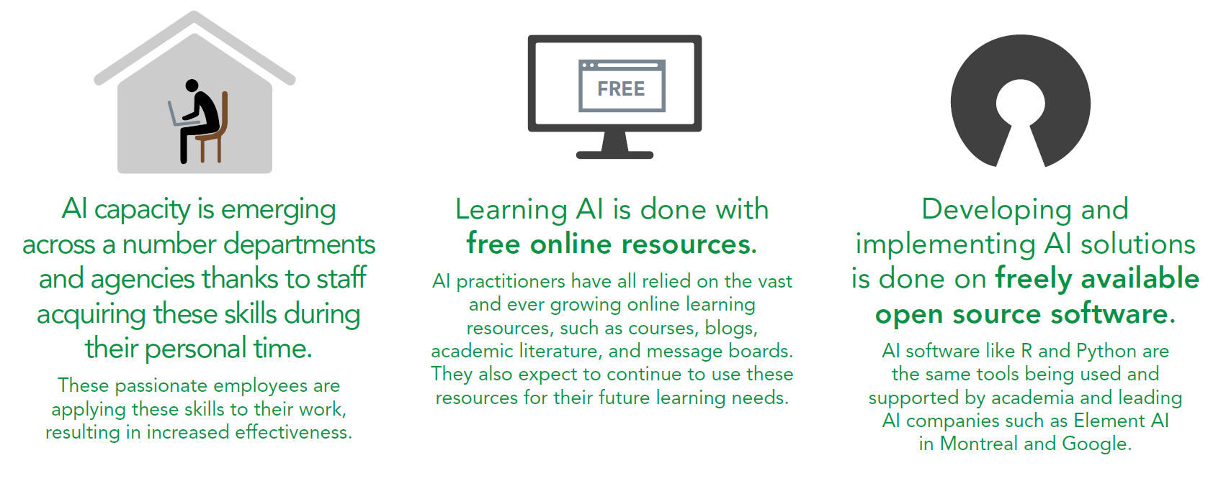
AI capacity building in the GC
14

Slide 15
A model for success
1
Creating a foundation for all public servants
At the CSPS Digital Academy, we’re working on how best to answer the questions:
Will our learning help people do their jobs?
Will our learning products help the right people, and enough of them?
The answer is a three pronged model that helps focus on individual, organizational, and systemic change.
2
Applied digital mindsets and skills for practitioners
3
How to lead in a digital age
15

Slide 16
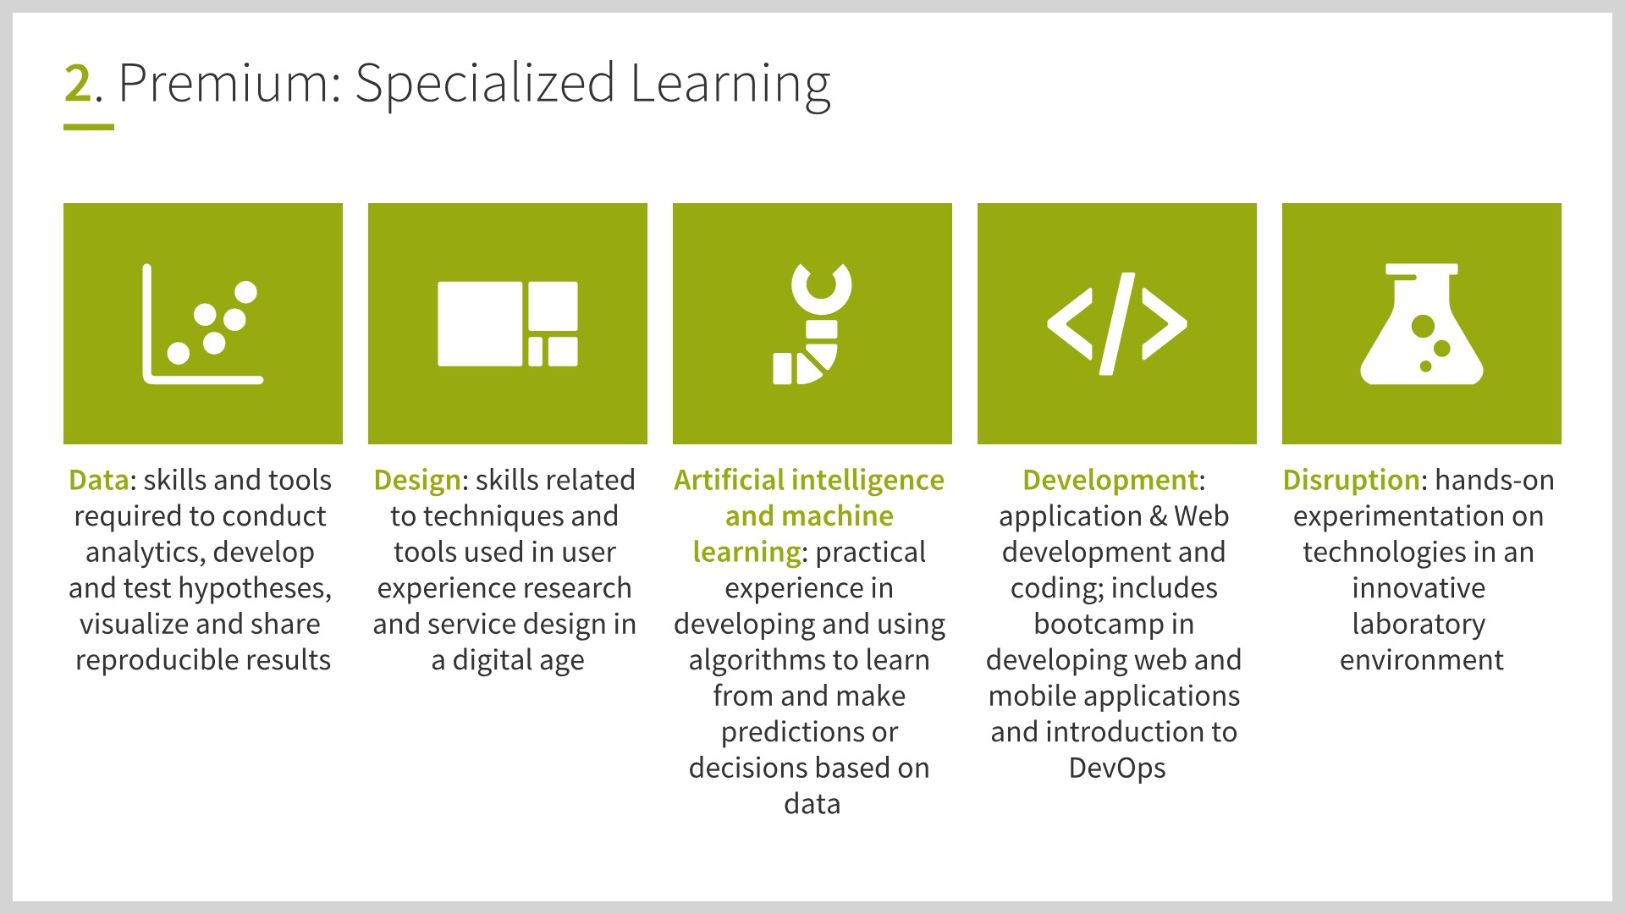
AI as an Academy focus area
16

Slide 17
Supporting AI work across the GC
The GC led on the D9 guiding principles for AI.
To ensure the effective and ethical use of AI the government will:
Understand and measure
the impact of using AI by developing and sharing tools and approaches
Be transparent
about how and when we are using AI, starting with a clear user need and public benefit
Provide meaningful explanations
about AI decision making, while also offering opportunities to review results and challenge these decisions
Be as open as we can
by sharing source code, training data, and other relevant information, all while protecting personal information, system integration, and national security and defence
Provide sufficient training
so that government employees developing and using AI solutions have the responsible design, function, and implementation skills needed to make AI-based public services better
17
Notes:
https://www.canada.ca/en/government/system/digital-government/responsible-use-ai.html

Slide 18
Policy and guidance
TBS has rolled out rules, standards, and tools necessary to implement AI responsibly:
Directive on Automated Decision Making
Algorithmic Impact Assessment
A 35-minute questionnaire that helps departments assess the levels of risk and impact from AI applications for a given initiative
Pre-qualified source list for AI vendors
18
Notes:
https://www.canada.ca/en/government/system/digital-government/responsible-use-ai/list-interested-artificial-intelligence-ai-suppliers.html

Slide 19
Top ten things to do next
Get cloud and give your people access
Migrate or build your business applications and data
Give your people access to modern data tools (Python & R) and the equipment they need:
GPU acceleration
Linux
Lots of libraries (Tensorflow, Keras, etc.)
Train or find specialized expertise
Start running modern analytics and visualizations to understand your data
Build your DevOps capacity (testing, continuous integration/deployment, containerization, cluster-computing)
Pick a business problem
Develop and test your models, continuously, with a multi-disciplinary team
Develop a data pipeline around your models
Improve policy, service, and program outcomes using AI
…if you’re not ready for #1-6, you’re not ready to apply AI to business problems.
19

Slide 20
Practical next steps
Email neil.bouwer@Canada.ca to talk AI for program, policy, and service improvement
Email christopher.allison@Canada.ca to partner on AI pathfinder projects with the CSPS Digital Academy
Email csps.digitalacademy-academiedunumerique.efpc@canada.ca for information about the CSPS Digital Academy and building capacity and mindsets for digital
20
Notes:
https://www.canada.ca/en/government/system/digital-government/responsible-use-ai/list-interested-artificial-intelligence-ai-suppliers.html

Slide 21
A(I)nnex
21
Notes:
Ipsos 2018

Slide 22

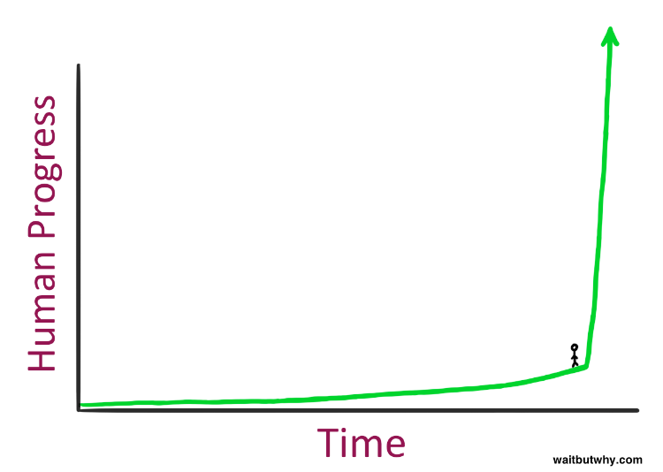

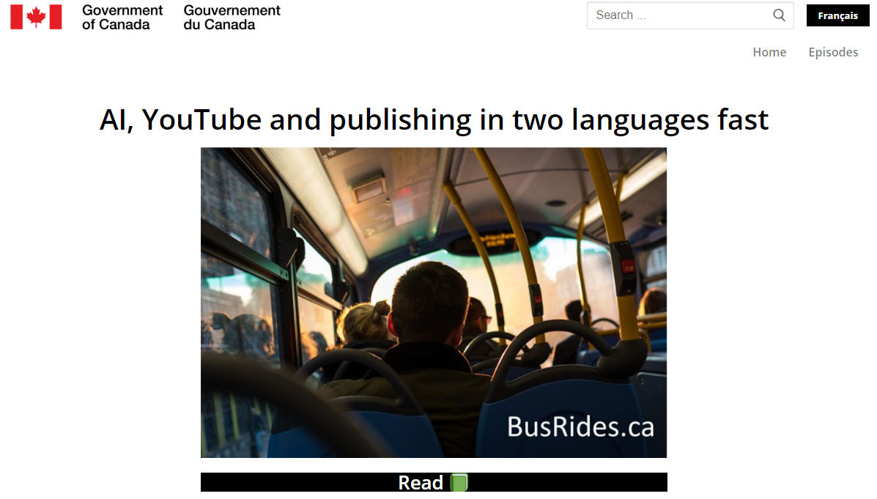
Reading list
Prediction Machines
Ajay Agrawal, Avi Goldfarb, and Joshua Gans
The AI Revolution
Tim Urban
https://waitbutwhy.com/2015/01/artificial-intelligence-revolution-1.html
Weapons of Math
Destruction
Cathy O’Neil
AI, Youtube, and publishing in two languages fast
The Digital Academy
https://en.busrides-trajetsenbus.ca/episode-2/
22
Notes:
https://www.canada.ca/en/government/system/digital-government/responsible-use-ai/list-interested-artificial-intelligence-ai-suppliers.html

Slide 23
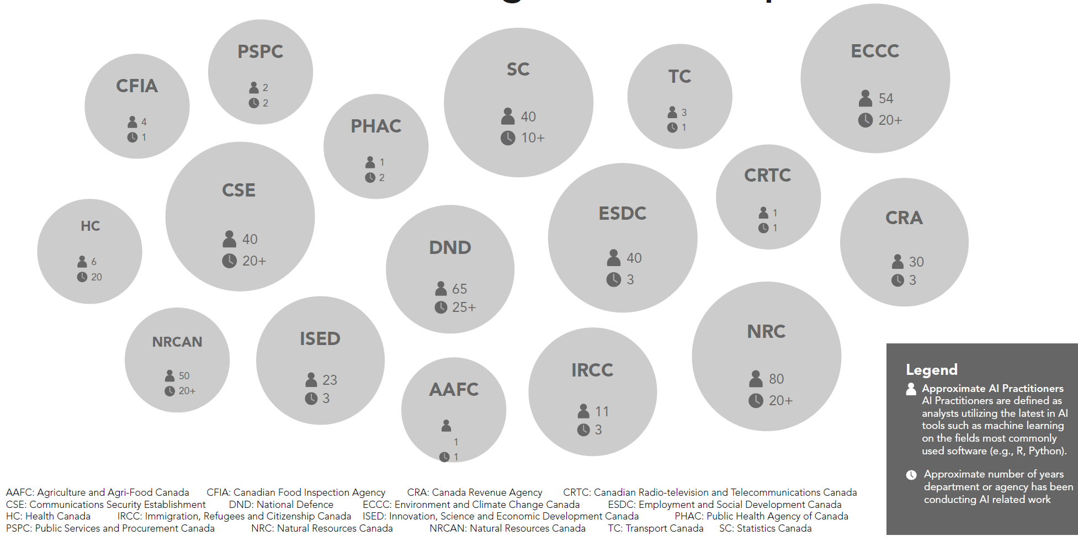
AI in the GC

Slide 24
Governing and supporting AI
Treasury Board Secretariat – Provides central leadership to GC on digital government, TB policy suite and oversight, Project review, Lead on open government/data, Employer of the Public Service
ISED – Coordinates external AI stakeholders, including the AI Advisory Council, Pan-Canadian AI Strategy, Supercluster Initiative, and Government’s of France and Canada Working Group
Canada School of Public Service – Offers training and enables experimentation
Justice Canada – Reviews and provides legal opinions related to the intersection of AI and the law
Statistics Canada – Performs enterprise data management, governance, and analysis
Public Services and Procurement Canada – Provides vehicles and support tools to enable the efficient, effective, and consistent procurement of AI across the government.
Employment and Social Development Canada – Leads social policy lead
Canada Digital Services – Supports business transformation through direct departmental support
Shared Services Canada – Provides large scale/centralized IT support
NRC – Supports departments and external stakeholders through education and funding opportunities
24
Notes:
https://www.canada.ca/en/government/system/digital-government/responsible-use-ai.html

Slide 25
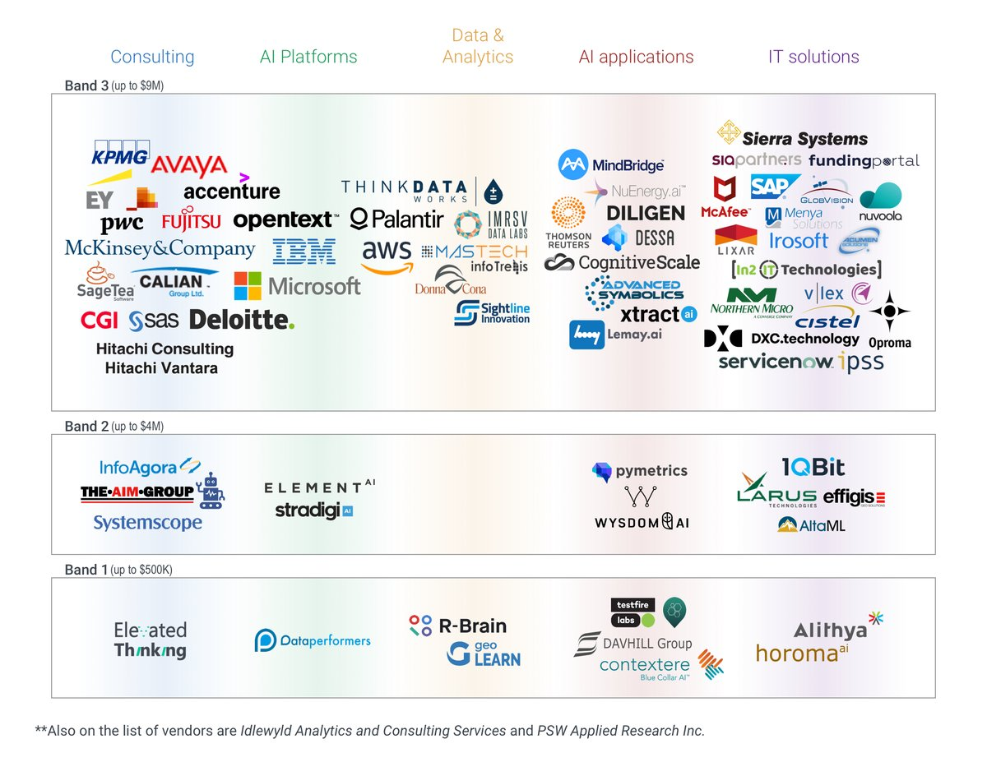
AI procurement options
25
Notes:
https://www.canada.ca/en/government/system/digital-government/responsible-use-ai/list-interested-artificial-intelligence-ai-suppliers.html

Slide 26
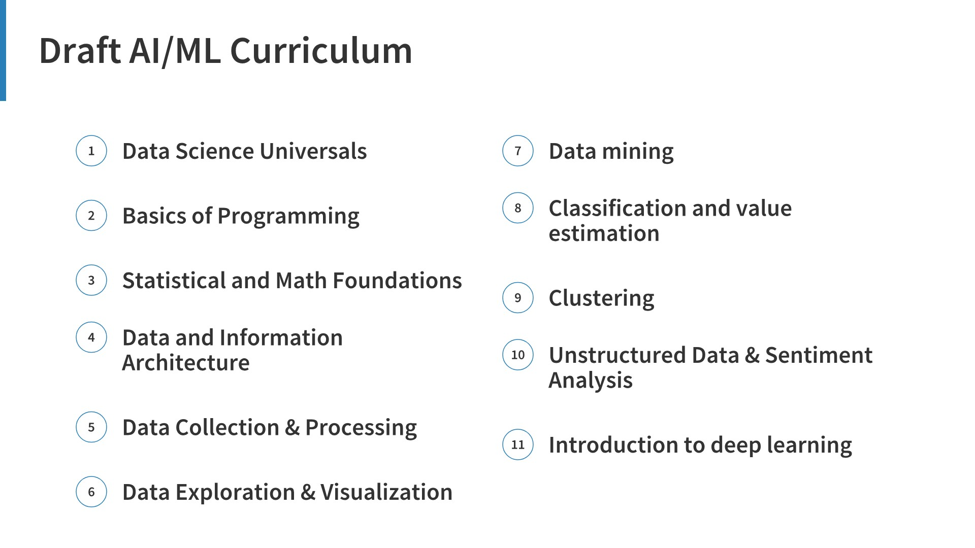
26

Slide 27
Interdepartmental governance
Governance aligned with existing enterprise practices will support the effective and responsible implementation of AI in the GC
DM CEPP
TBS
NRC
ISED
CSPS
StatCan
Justice
PSPC
SSC
Oversee project funding
Policy coordination
Ethical/technical advice and oversight
Discussion of training curricula
ADM CEPP
GC EARB
Data Steering Committee
Gov AI Steering Committee
Enterprise Data Community of Practice
Enterprise AI Community of Practice
All GC
Technical assistance, learning, coordination
27
Notes:
https://www.canada.ca/en/government/system/digital-government/responsible-use-ai/list-interested-artificial-intelligence-ai-suppliers.html

Slide 28
Examples of AI applications in the GC
Department | Use Case
NRCAN | Forest fire protection and flooding map Optimizing industrial process and performance Extraction of features from high-definition images
TC | Risk-based oversight of air cargo
PHAC | Early warning of worldwide public health threats (in collaboration with NRC)
HC | Automation of repetitive rules-based tasks Assessment of risk communication activities
ISED | Identifying debtors who may warrant investigation
CSA | Next generation holographic console
CRC | Management of spectrum Engineered surfaced design
DND | Underwater, ground, and airborne autonomous systems Ground, airborne, and space sensor processing Decision support systems, knowledge-based reasoning
ECC | Meteorological and environment modelling processes The creation of land cover information from satellite data Improved and automatic classification of sea ice The characterization, mapping, and monitoring of ecosystems and habitats important to wildlife
NRC | Tracking greenhouse gases in the port of Montreal Teaching machines disappearing indigenous languages Helping to manage power consumption in buildings
28
Notes:
https://www.canada.ca/en/government/system/digital-government/responsible-use-ai/list-interested-artificial-intelligence-ai-suppliers.html

